Slide 1

Delivering World Class Radiotherapy
Independent Cancer Patient Voices
Tim Cooper
National Cancer Action Team

Slide 2

Advancing Radiotherapy
Many of the newer
radiotherapy techniques
require expensive equipment
and well-trained therapists.
Friday, Oct. 06, 1961

Slide 3
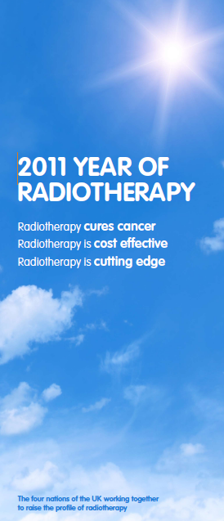
2011
The Year of Radiotherapy

Slide 4


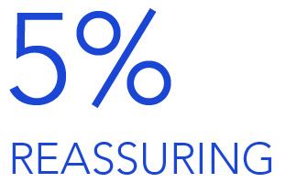
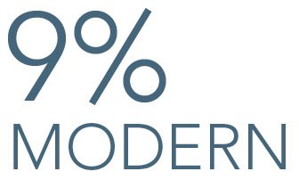
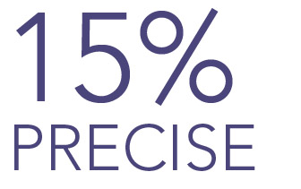
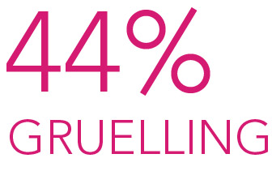
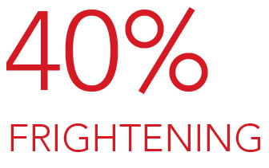
SURVEY RESULTS
Notes:
Radiotherapy as a modern treatment
Fewer than one in ten people thought radiotherapy is a modern cancer treatment (9% of respondents).
But, almost half (47%) thought targeted cancer drugs, like Herceptin, are modern.
Given the lower overall awareness of targeted cancer drugs, this difference is more significant that it may initially appear.
Radiotherapy word association
Respondents were given a list of words and asked to select which they associated with radiotherapy.
Precise - Only 15% of people associated this word with radiotherapy.
Gruelling - 44% of people chose this word to describe radiotherapy (compared to just 11% of people who chose this word to describe targeted cancer therapy)
Frightening – 40% of people chose this word to describe radiotherapy (compared to just 16% for targeted cancer therapy)
Reassuring – Only 5% of people chose this word to describe radiotherapy
Other views on radiotherapy
Respondents were given a list of statements and asked to indicate which they felt were true in regard to radiotherapy.
More than one quarter (29%) thought radiotherapy treatment always makes you feel sick.
16% thought radiotherapy always makes you lose your hair.
11% thought radiotherapy is a type of cancer drug.

Slide 5
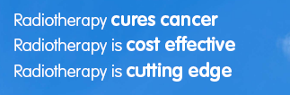
2011
The Year of Radiotherapy

Slide 6
Radiotherapy contributes to the cure of cancer

Slide 7
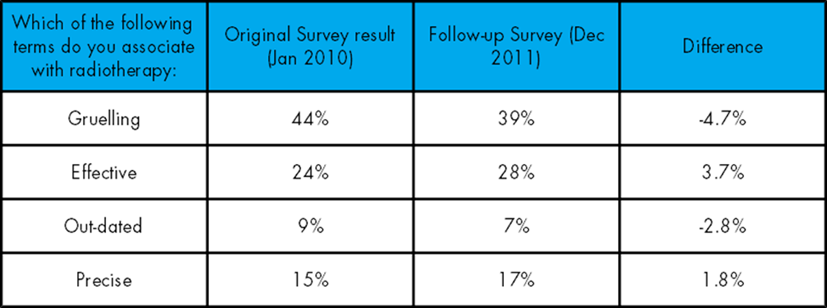

Slide 8
Key Message –
Improving Outcomes Strategy
  Access to radiotherapy is critical to improving outcomes and, to improve outcomes from radiotherapy, there must be equitable access to high quality, safe, timely, protocol-driven quality-controlled services focused around patients’ needs.

Slide 9
Key Message –
Improving Outcomes Strategy
  Access to radiotherapy is critical to improving outcomes.
  To improve outcomes from radiotherapy, there must be equitable access to high quality, safe, timely, protocol-driven quality-controlled services focused around patients’ needs.

Slide 10
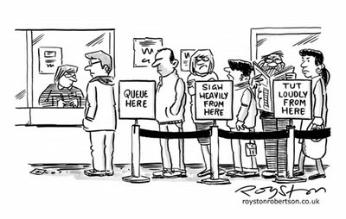

Slide 11
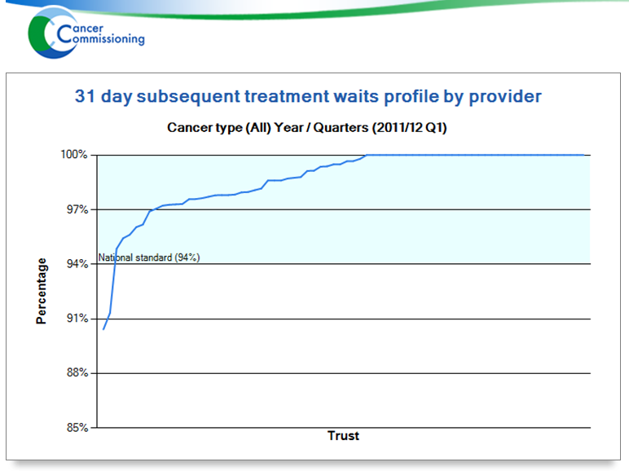
31 day subsequent Q1 11/12
National Average 98.2%

Slide 12

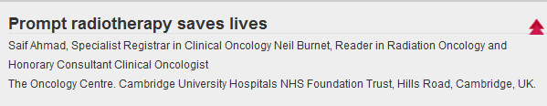
31 day waits
Ahmad and Burnet 2011
Saves 2,500 lives each year
http://www.bmj.com/content/343/bmj.d4286/reply#bmj_el_268127

Slide 13
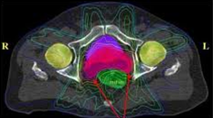
IMRT
At least one centre in each network by 2012
Uptake increasing.
ASW modelling shows financially as well as clinically cost effective for H&N
33% radical fractions
Reviewing the evidence

Slide 14
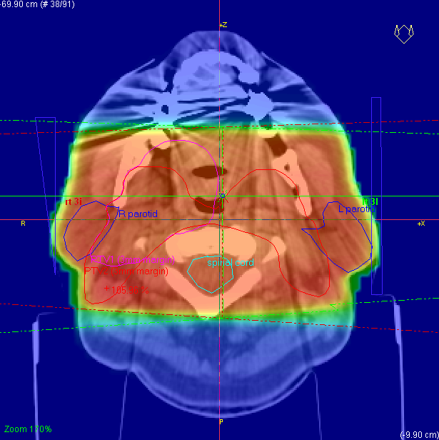
Previous practice

Slide 15
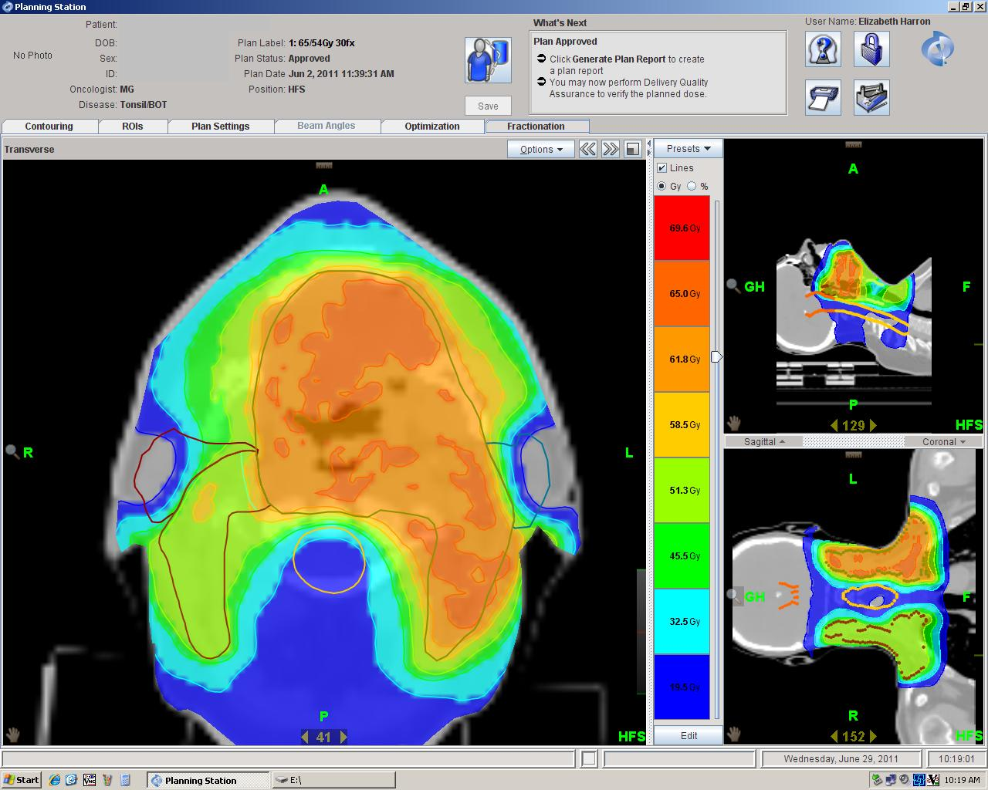

Slide 16
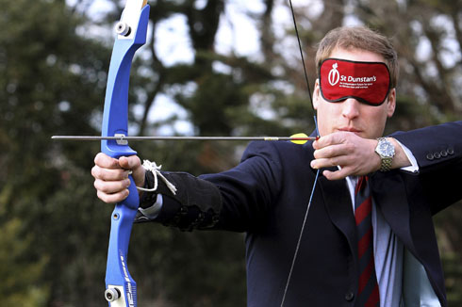
The need for image guidance in modern radiotherapy
How confident are we that we can hit the target & avoid collateral damage?

Slide 17
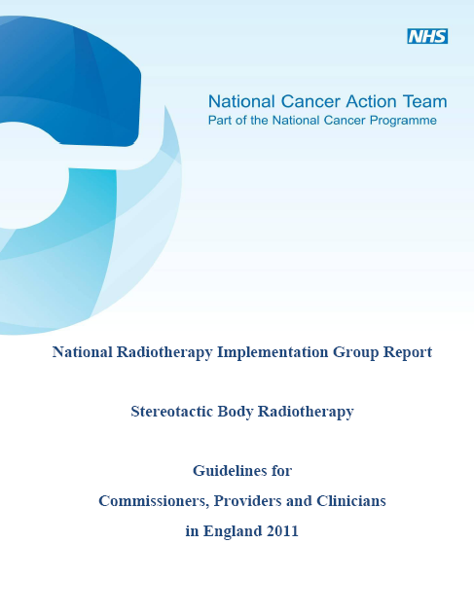
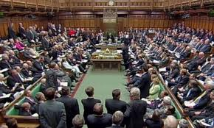
Stereotactic Radiotherapy

Slide 18

Radiotherapy National Report
Update on progress
Use national RTDS
Retain and reinforce NRAG
Refresh metrics
Re-set the horizon

Slide 19
Commissioning
Radiotherapy is in ‘minimum take’
Agree standard of care
Generic Specification
Commissioning dashboard
Assess local challenges in moving to standard of care - local trajectories

Slide 20
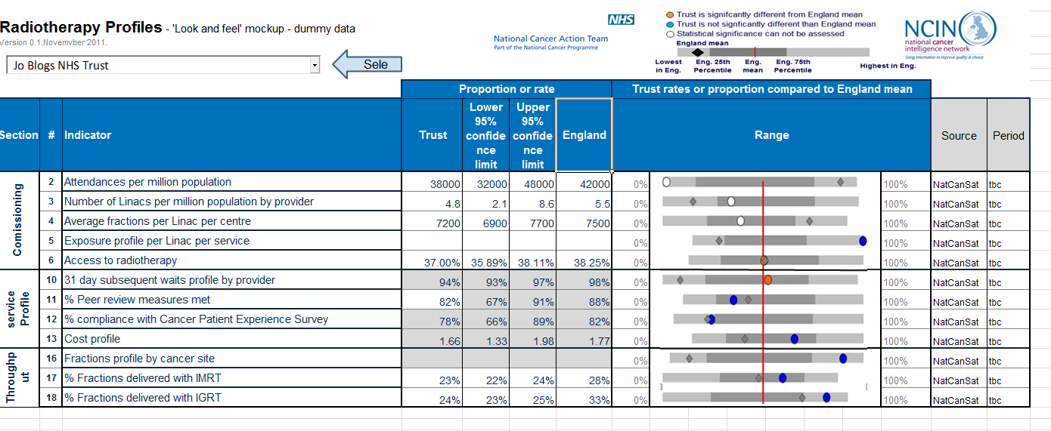
Service Profiles

Slide 21
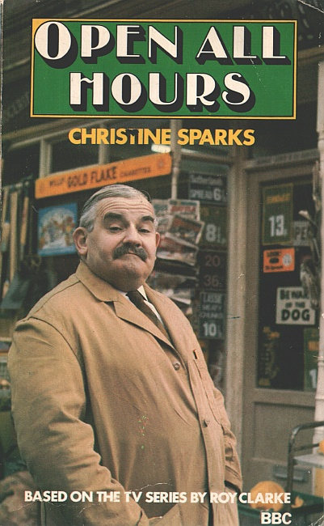

Slide 22


Slide 23

So what is World Class

Slide 24
Achieving a world class radiotherapy service across the UK
Recommendation 1: Planning for the future
a rolling ten-year plan, setting out a vision and strategy for future radiotherapy services,
Recommendation 2: Measuring success
datasets for the reporting of fractionation, waiting times, access, and patient outcomes.
Recommendation 3: Ensuring equity in access
demand modelling based on differences in cancer incidence on a region-by-region basis.
Recommendation 4: Training the radiotherapy workforce
A national career promotion strategy should be introduced across the four nations of the UK
Recommendation 5: Integrating new technologies
NICE should provide national guidance on novel radiotherapy techniques, such as intensity modulated radiotherapy (IMRT) and proton therapy.
Recommendation 6: Communicating with the public
formulate a strategy and proposal for awareness raising about radiotherapy.

Slide 25



Slide 26
